Slide 1
Final Course Project
CEIS-106 Operating Systems
Module 8
Andrew Newhart

Slide 2
Course Project
Operating Systems
Module 2 Linux Filesystem Hierarchy

Slide 3
Rubric
Activity | Requirement(s) | Points
Navigate the Linux filesystem tree | Answer two questions | 12
Create directories and files | Take a screenshot | 6
Copy and remove directories and files | Take a screenshot | 6
Locate directories and files | Take a screenshot | 6

Slide 4
Navigate the Linux filesystem tree
1. What is the pwd command an acronym for? What about the cd command?
Answer here: Present Working Directory – Or where are you sitting in the File System Tree
2. Explain the differences between a relative path and an absolute/full path in Linux.
Answer here:
A relative path starts from the current directory
absolute/full path The Absolute path always starts from the root directory
References:
1. linuxhandbook.com

Slide 5
Create directories and files
Take a screenshot of the output in Steps 5 and 6.

Slide 6
Copy and remove directories and files
Take a screenshot of the output in Step 3.

Slide 7
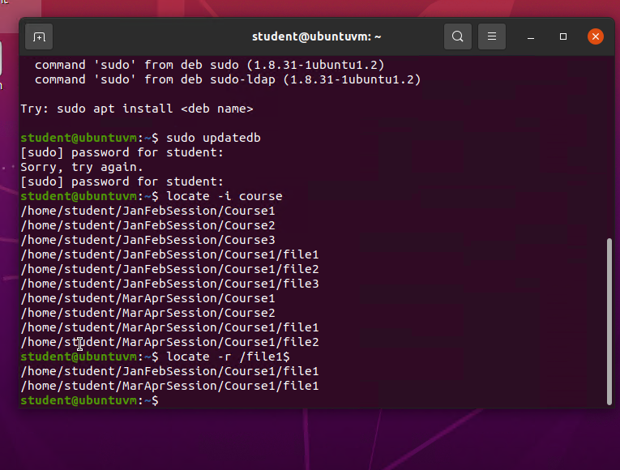
Locate directories and files
Take a screenshot of the output in Steps 5 and 6.

Slide 8
Course Project
Operating Systems
Module 3 Linux Shell Scripts
CEIS-106 Andrew Newhart 060522

Slide 9
Rubric
Activity | Requirement(s) | Points
Create a shell script | Answer three questions | 15
Change script file permissions | Take a screenshot | 15
Set the PATH variable | Take a screenshot | 15
Make the PATH variable permanent | Take a screenshot | 15

Slide 10
Create a shell script
1. What are the file permissions of the script?
Answer here:
-rw-rw-r- -
2. What’s the name of the user-defined variable in the script?
Answer here: text
3. Which redirection meta-character is used in the script? What does it do?
Answer here: echo “” >> MyToDoLists
References:
1.
2.

Slide 11
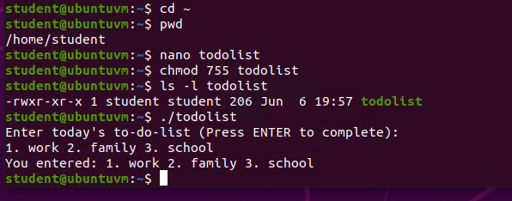
Change script file permissions
Take a screenshot of the output in Step 5.

Slide 12
Set the PATH variable
Take a screenshot of the output in Step 6.

Slide 13
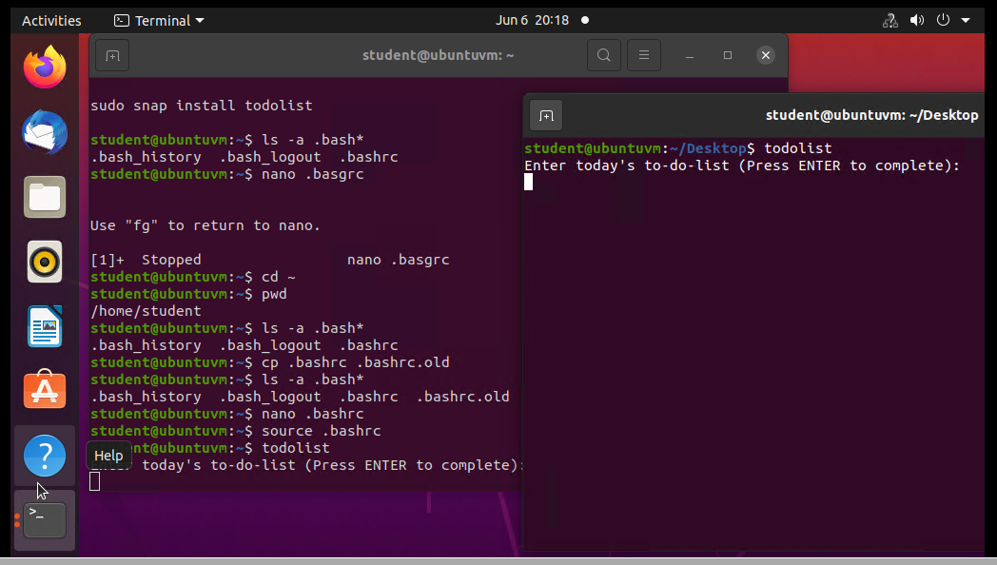
Make the PATH variable permanent
Run the todolist script before and after making the PATH variable permanent. Take a screenshot of both Terminal windows.

Slide 14
Course Project
Operating Systems
Module 4 User and Group Management
CEIS-106 Module 4
Andrew Newhart 060605

Slide 15
Rubric
Activity | Requirement(s) | Points
Add users and groups in CLI | Answer three questions | 15
Test user and group settings | Take a screenshot | 15
Add users in GUI | Take a screenshot | 15
Remove users and groups | Take a screenshot | 15

Slide 16
Add users and groups in CLI
1. What does the –m option in the useradd command do?
Answer here: Prevents the home directory from being created regardless of system settings.
2. What does the -3 option in the tail command do?
Answer here: display the last three lines of the userlist file
3. Which line of the /etc/group file lists members of the “students” group? Copy it here.
Answer here:
References:
1. Quizlet
2.

Slide 17
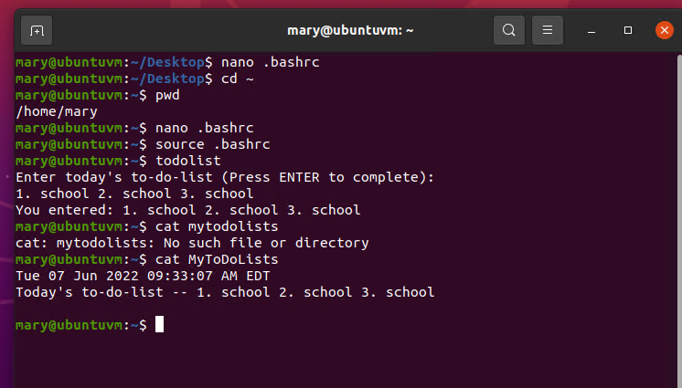
Test user and group settings
Take a screenshot of the output in Step 6.

Slide 18
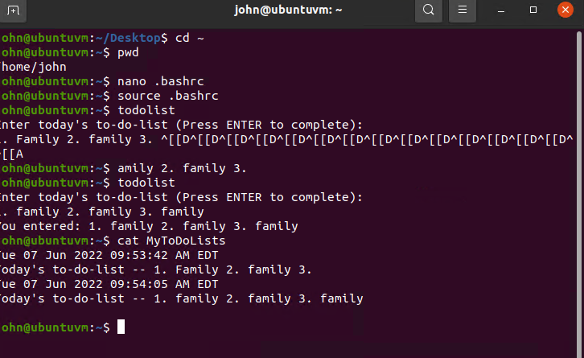
Add users in GUI
Take a screenshot of the output in Step 9.

Slide 19
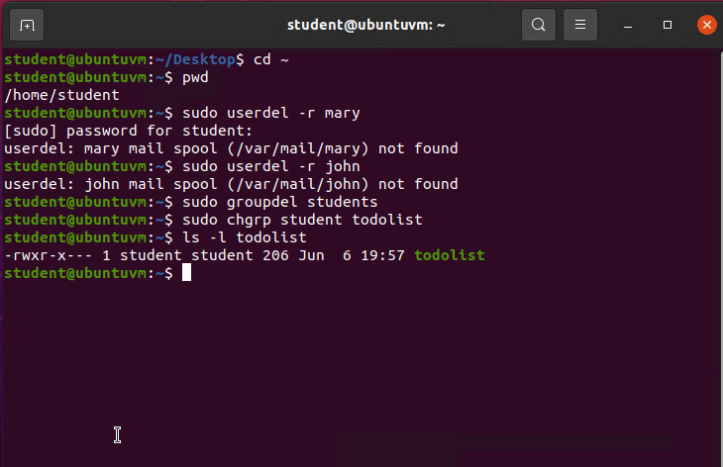
Remove users and groups
Take a screenshot of the log on page with three user accounts.
Take a screenshot of the log on page with only your user account (i.e., student).

Slide 20
Course Project
Operating Systems
Module 5 Network Configuration
CEIS-106
Andrew Newhart 060722

Slide 21
Rubric
Activity | Requirement(s) | Points
Discover host IP configurations | Answer four questions Take a screenshot | 20
Manage network interfaces | Answer two questions | 20
User network utilities | Take a screenshot | 20

Slide 22
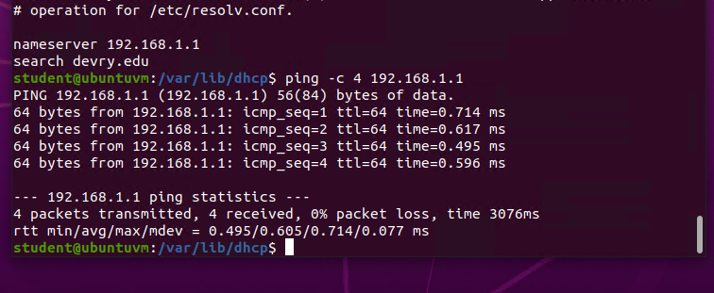
Discover host IP configurations
1. What is the IP address of your Ubuntu machine?
Answer here: 192.168.1.104/24
2. What is the IP address of its default gateway?
Answer here: 192.168.1.1
3. What is the IP address of its DHCP server?
Answer here: 192.168.1.1
4. What is the IP address of its DNS server?
Answer here: 192.168.1.1
Take a screenshot of the output in Step 6.

Slide 23
Manage network interfaces
1. Which DHCP message is shown in the output of the sudo dhclient –v –r eth0 command? [hint: the message name is in uppercase.]
Answer here: DHCPRELEASE of 192.168.1.105 on eth0 to 192.168.1.1 port 67
2. Which four DHCP messages are shown in the output of the sudo dhclient –v eth0 command? [hint: the message names are in uppercase.]
Answer here:
References:
1.
2.

Slide 24
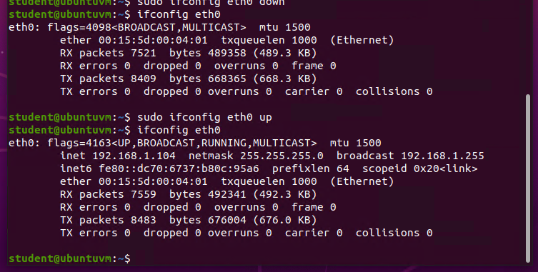
Use network utilities
Take a screenshot of the output in Step 5.

Slide 25
Course Project
Operating Systems
Module 6 System Performance Monitoring
CEIS-106 Module 6 Project 6/8/22
Andrew Newhart

Slide 26
Rubric
Activity | Requirement(s) | Points
Monitor processes | Answer two questions | 20
Monitor user activities | Answer two questions | 20
Monitor network bandwidth usage | Take a screenshot | 20

Slide 27
Monitor Linux processes
1. What is the default action of the 15 SIGTERM kill signal?
Answer here: close the window hosting the app
2. In the System Monitor window, click on % CPU to sort the processes by CPU load. Which process shows the highest percentage of CPU usage?
Answer here: gnome-shell
References:
1.
2.

Slide 28
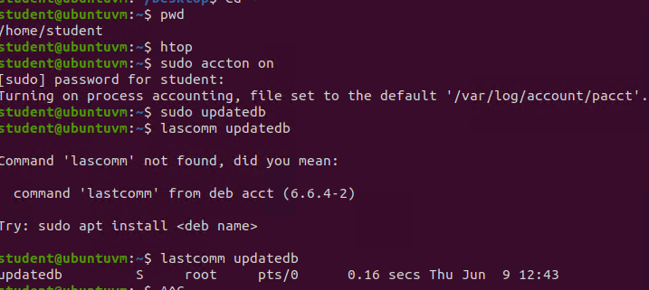
Monitor user activities
Issue the sudo accton on command to turn on GNC accounting. Run the sudo updatedb command. Enter lastcomm updatedb to check if the updatedb command was executed before. Remember to turn off GNC accounting (sudo accton off) after answering the questions.
1. What flag value is displayed in the output?
Answer here: S
2. Why is the name of the user who ran the processes shown as root, not student?
Answer here: root
References:
1.
2.

Slide 29
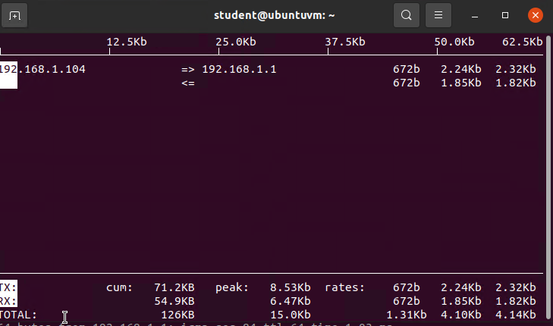
Monitor network bandwidth usage
Take a screenshot of the output in Step 4.

