Slide 1
SEC285 Module 2 Asymmetric Key Encryption Andrew Newhart

Slide 2
Rubric
Activity | Requirement(s) | Points
File Encryption | Screenshot | 15
File Decryption | Screenshot | 15

Slide 3
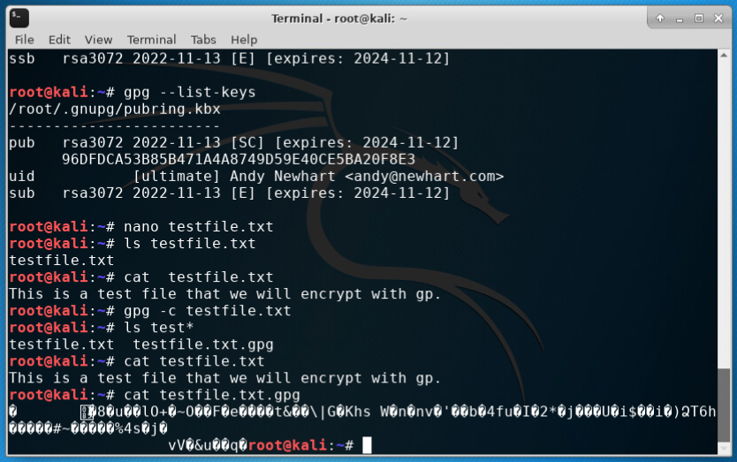
File Encryption
This screenshot should show the following.
Content of the plaintext file
Content of the encrypted file

Slide 4
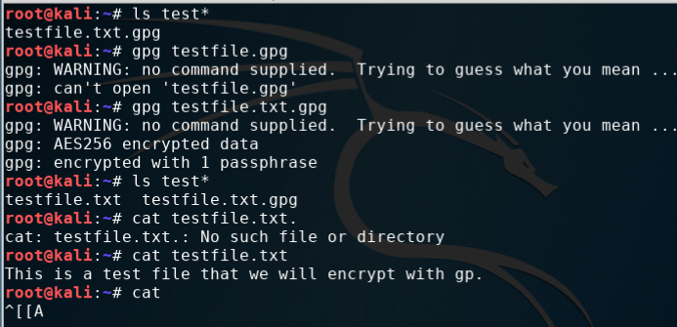
File Decryption
This screenshot should show the following.
The encrypted file being listed by itself
The decrypting process
Both the encrypted file and the original plaintext file being listed

Slide 5
SEC285 Module 2 - Asymmetric Key Encryption
Conclusions and knowledge gained
This was a good look at Asymmetric Key Encryption.
The results clearly demonstrate the results of encrypting the files on the Linux cli.
The project lab taught the steps to generate an encryption key using the gpg utility.
I had a good understanding of the utility and the use of rewards of encrypting your data and rest and in motion and the encryption keys make that possible.
Andrew Newhart

Slide 6
SEC285 Module 3 Stateful Firewall Andrew Newhart 12/11/22

Slide 7
Rubric
Activity | Requirement(s) | Points
Question | Answer | 30
Nmap Scan | Screenshot | 30

Slide 8
Question
What effect does the sudo iptables --policy INPUT DROP command have on the access to computing resources?
Answer here: IPTABLES is just a resource for a CLI firewall utility in the Unix arena. If you would rather deny all connections and manually specify which ones you want to allow to connect, you should change the default policy of your chains to drop.
With your default chain policies configured, you can start adding rules to iptables so it knows what to do when it encounters a connection from or to a particular IP address or port.
CLI: iptables --policy INPUT DROP - Drop – Drop the connection, act like it never happened. This is best if you don’t want the source to realize your system exists.
The example preformed in the mod 3 lab closed all connection to the server that used the INPUT DROP command
References: https://www.howtogeek.com/177621/the-beginners-guide-to-iptables-the-linux-firewall/

Slide 9
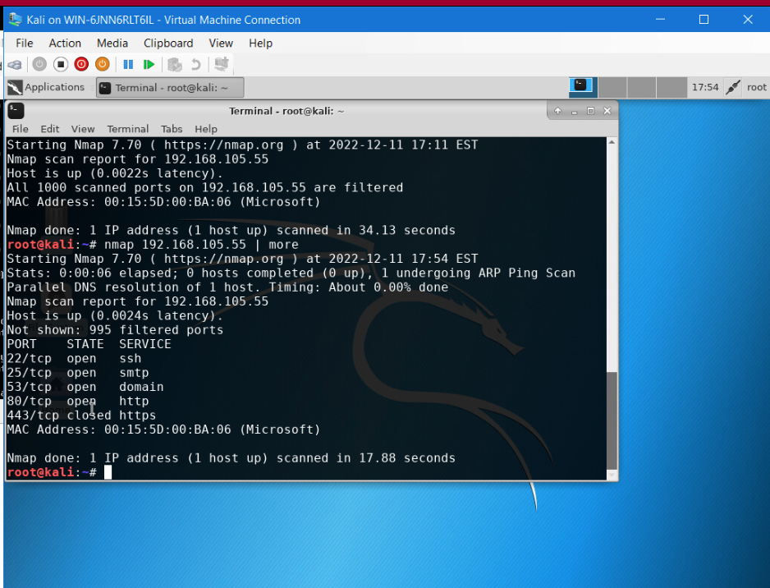
Nmap Scan
This screenshot should show the Nmap scan result of the Linux Server VM.

Slide 10
SEC285 Module 3 - Stateful Firewall
Conclusions and knowledge gained
The project as a valuable lab on working with the nmap command and iptables.
Iptables where not around when I was installing networks in the 80’s and 90’s so I can see where this function will help maintain the flow of secured data through your firewall and onto your network.
iptables is a user-space utility program that allows a system administrator to configure the IP packet filter rules of the Linux kernel firewall, implemented as different Netfilter modules.
The filters are organized in different tables, which contain chains of rules for how to treat network traffic packets. This is a good use of tech to resolve traffic direction and relieve other firewall operations by weeding out packets based on rules established by the iptables.
This was a great upload of knowledge into my skill-set and I am sure will be invaluable in my future dealings with firewalls.

Slide 11
SEC285 Module 4 Bring Your Own Device (BYOD) Security Policy Andrew Newhart

Slide 12
Rubric
Activity | Requirement(s) | Points
BYOD Security Policy | The complete policy template | 60

Slide 13
1. Overview: BYOD as a SMB IT policy.
Security has always been a multi-faceted issue for organizations that leverage mobile device strategies such as BYOD, choose-your-own-device (CYOD), corporate-owned, personally enabled (COPE) devices, and corporate-owned, business-only (COBO) devices.
However, the BYOD trend presents a more complex security environment than company-owned devices. For one, employee-owned endpoints usually contain employees’ personal information in addition to corporate data. It can be much harder to mandate (through technical or policy controls) certain configurations, application use, or how much an employee can engage in “personal,” i.e. non-work related, activities.
2. Purpose:
The main purpose of developing a BYOD device policy would be to set a clear set of parameters defining the AUP of personal devices and what access can be given to a users device. The goal is to keep any possible threat from an infected personal device to access your company secured network.

Slide 14
3. Scope:
It can be much harder to mandate (through technical or policy controls) certain configurations, application use, or how much an employee can engage in “personal,” i.e. non-work related, activities.
To help make clear definitions of expected use of company data and application on personal user devices a BYOB policy will set the terms and requirements as well as prerequisites required to allow a personal device to access the data or work network.
4. Policy:
The AUP of company applications and data access is clearly defined in this policy and will develop discovery techniques used on a regular basis to minimize threats from an infected or compromised security system on a personal use device.
Personal use devices used to access the company network or any of its resources has to comply with regular scheduled ad well as random threat assessment of the device and its security settings.

Slide 15
5. Policy Compliance:
Compliance to all security parameters defined here must be adhered to allow the users device access to company resources.
In the event a vulnerability or threat is discovered on a personal device trying to access or utilize company network resources or data the user must surrender to a devices analysis and security assessment and remain locked from the network by device MAC or user id until which time the threat can be neutralized and the device returned in a cleaned and secure condition.
An employee found to have violated this policy may be subject to disciplinary actions up to and including termination of employment.
6. Related Standards, Policies, and Processes:
The standards used to help define this policy are included in the NIST documents NIST 800-171

Slide 16
7. Definitions and Terms:
BYOD – Bring Your Own Device
CYOD – Choose Your Own Device
COPE – Corporate Owned Personally Enabled Device
COBO – Corporate Owned Business Only Device
AUP – Acceptable Use Policy
MAC – Media Access Control Address
8. Revision History:
Date of change | Responsible | Summary of change
December 19 2022 | Original Creation | New Policy

Slide 17
SEC285 Module 4 - The BYOD Security Policy
Conclusions and knowledge gained
This was the hardest module for me.
The context of the lesson was clear and I understand it but policy writing is not my greatest skill.
I do understand and can see the need to define and create policies to define the use and operation of any company resource as well as any device allowed to access company resources, data or networking.
As a previous small business owner in the IT industry I came to understand in the early stages of ramping up our firm from few contractors to a dozen tech vans and a twenty-six techs across 8 offices and 17 states, that a clear AUP had to be written to define the use or our data and the company resources.
AUP’s for both IT, test and internal equipment had to be defined to keep a clear understating of expectation of security that was the responsibility of all employees and contractors.
Our policies where not as defined nor where that as much mobile access afforded users at that time but we still had to keep a vigil eye on the access to the network and all resources.

Slide 18
SEC285 Module 5 Multifactor Authentication (MFA) Andrew Newhart

Slide 19
Rubric
Activity | Requirement(s) | Points
Common-auth Configuration File | Screenshot | 30
MFA Logon Screen | Screenshot | 30

Slide 20
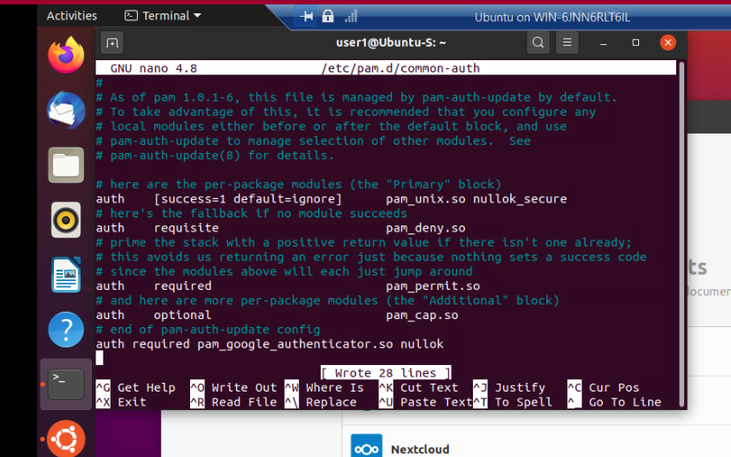
Common-auth Configuration File
This screenshot should show the entry that indicates the use of the Google Authenticator module.

Slide 21
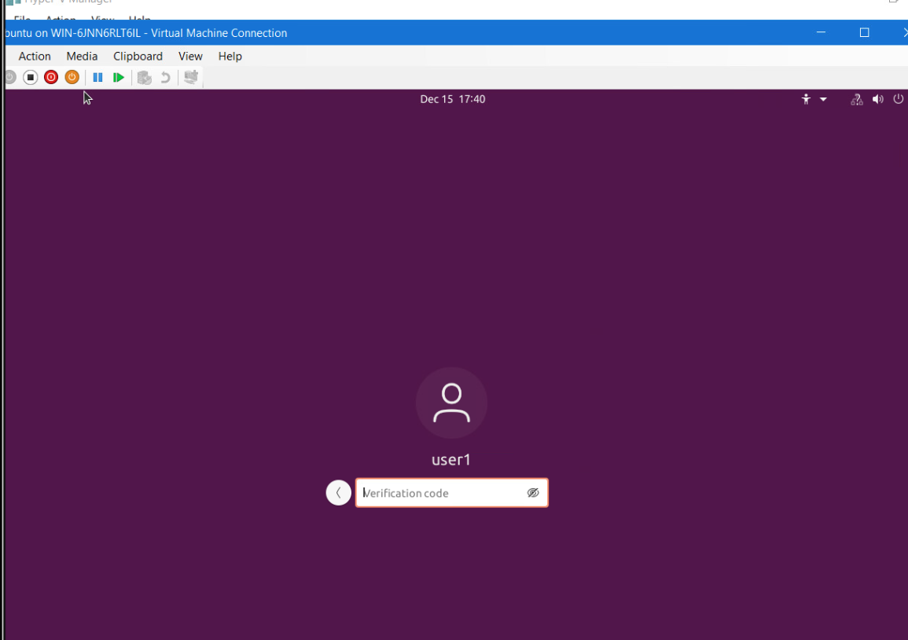
MFA Logon Screen
This screenshot should show the logon screen where a verification code is required.

Slide 22
SEC285 Module 5 - Multifactor Authentication (MFA) Conclusions and knowledge gained
This project was a great lesson on setting up MFA.
Using the google auth app was great to see and test. Most of my current MFA is biometric but I have set it up on all mobile apps and now have included in most of my internets sites that include any sensitive data or business operations such as; banking, insurance and other cloud apps.
MFA is a great option to help secure even your personal data and I recommend that everyone set it up on their banking connections at least.
Many sites will force you to set it up as Devry did and even prime now uses a MFA app that generates an approval page on a mobile app for access to your data.
MFA was a great and very useful addition to the authorization step of authenticating user access.

Slide 23
SEC285 Module 6 Vulnerability Assessment Andrew Newhart

Slide 24
Rubric
Activity | Requirement(s) | Points
Nmap | Screenshot | 15
NetCat | Screenshot | 15
Wireshark | Screenshot | 15
Nessus | Screenshot | 15

Slide 25
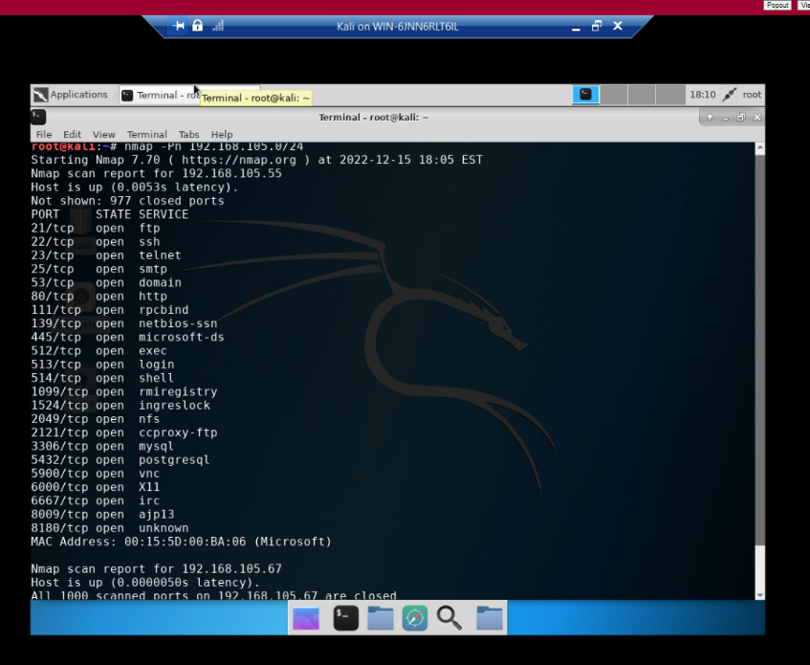
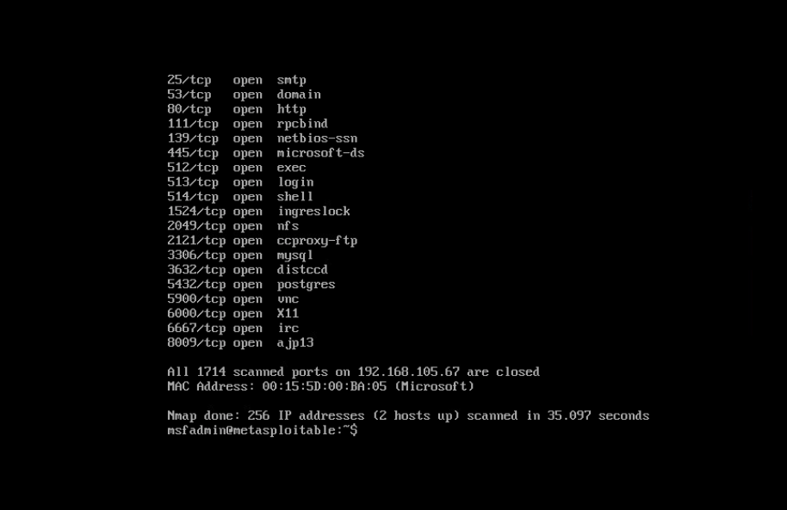
Nmap
This screenshot should include the scan result showing both the Kali and Linux Server VMs.

Slide 26
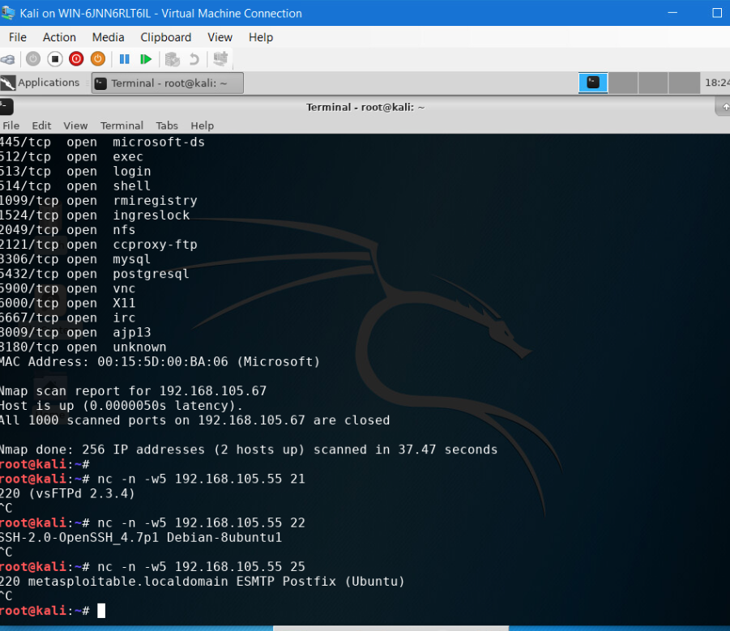
NetCat
This screenshot should include the scan result showing both the Kali and Linux Server VMs.

Slide 27
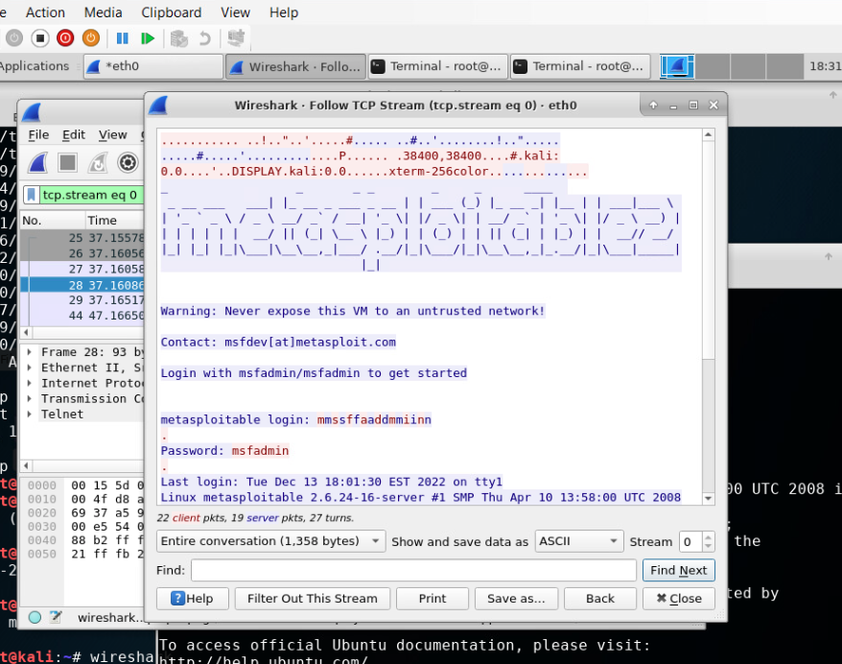
Wireshark
This screenshot should include the Wireshark—Follow TCP Steam window showing the Telnet username and password.

Slide 28
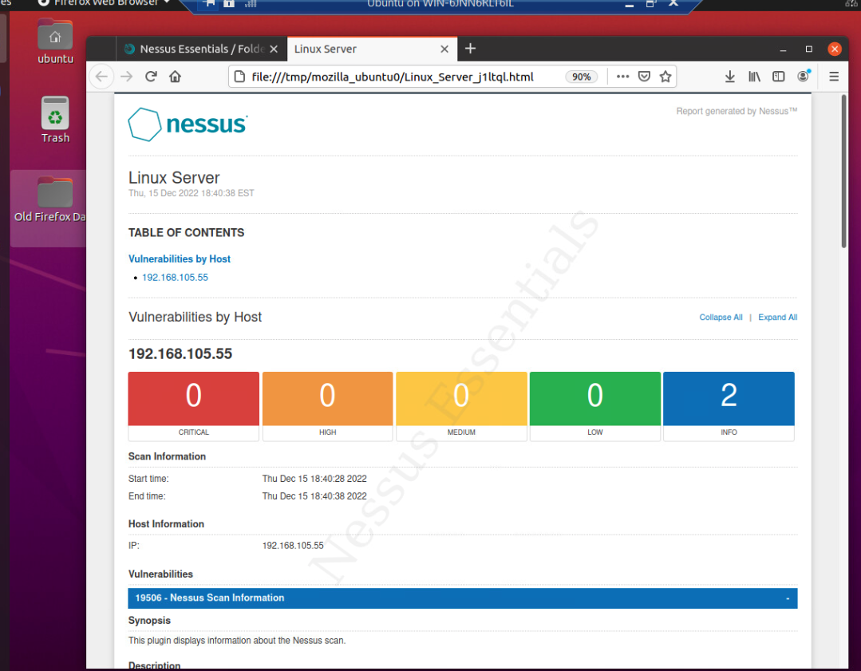
Nessus
This screenshot should include the high-level view of the Nessus vulnerability scan report (showing categories of vulnerability in different colors).

Slide 29
SEC285 Module 6 - Vulnerability Assessment Conclusions and knowledge gained
This project helped me get as handle on one of the utilities that I used in a much older version ..we called LAN sniffers.
Working on a CNX certification in the mid 90’s I was exposed to sniffing and disassembly of ethernet packets to help in locate LAN traffic issues.
NMAP and NCAT are surely useful commands but the wireshark and nessus utility surely make it a easier view of what's happening on your network.
The NESSUS utility is surely and easy way to look at your traffic and its impact on the lan.
I am nothing if not a layer 1 & 2 tech for over 30 years I have been developing and PM’ing infrastructure media and hardware included wireless bridging using Cisco 350 bridges to help connect data lans across local campus buildings.
I can remember in the days of the general network sniffers devices we used that helped us locate faulty ethernet interfaces on your lan.

