Slide 1
CEIS110 Module 8
FINAL PROJECT
Andrew Newhart 6/21/22

Slide 2
CEIS110 Module 2
Design and Library setup
Andrew Newhart

Slide 3
Rubric
Activity | Requirement(s) | Points
Develop Flowchart | Flowchart | 15
Software Library Installation | Screenshot of software library installed | 15

Slide 4
Flowchart
Include the following processes:
Install python
Download weather data to a database.
Extract weather data from database into a comma separated file with python
Cleanse weather data
Use Excel to manipulate data
Use python data analytics modules to develop graphical models

Slide 5
Software Inventory (Screenshots)
Include screenshot of NOAA-SDK library installed
Ensure result "Successfully installed noaa-sdk" of pip install command is visible in your screenshot.

Slide 6
CEIS110 Module 3
Downloading weather data

Slide 7
Rubric
Activity | Requirement(s) | Points
Code | Screenshot of code in Spyder with your name, date, and zip code | 10
Execution | Screenshot of Python console showing program ran successfully | 20
Database file | Screenshot from Windows Explorer showing database file was created | 20

Slide 8
BuildWeatherDb.py Code (Screenshot)
Screenshot of code in Spyder
Must have your name and date in comments
Must have your zip code

Slide 9
Python Console (Screenshot)
Screenshot of program output in Python console showing program executed successfully

Slide 10
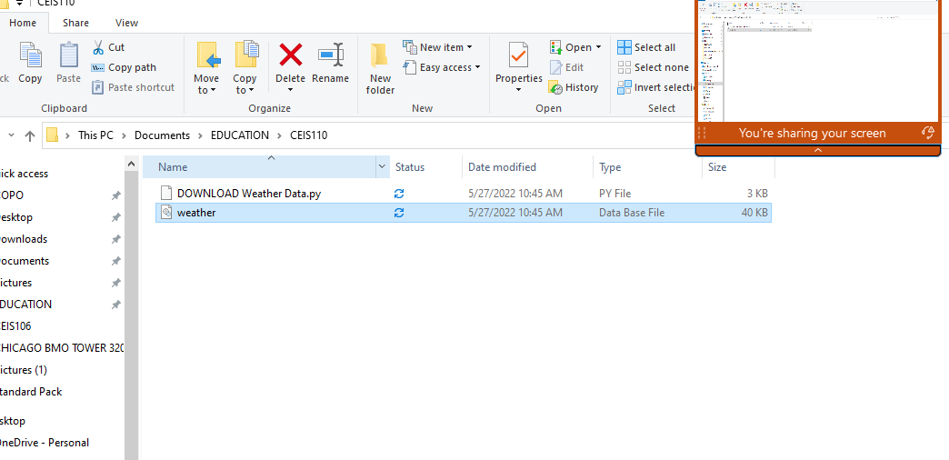
Weather.db File (Screenshot)
Screenshot of Windows Explorer showing database file Weather.db was created

Slide 11
CEIS110 Module 4
Querying the database with SQL
Andrew Newhart

Slide 12
Rubric
Activity | Requirement(s) | Points
Query to retrieve all columns and rows | Screenshot of query and results | 20
Query to retrieve lowest and highest temperature | Screenshot of query and results | 20
Query to find all Clear days | Screenshot of query and results | 20

Slide 13
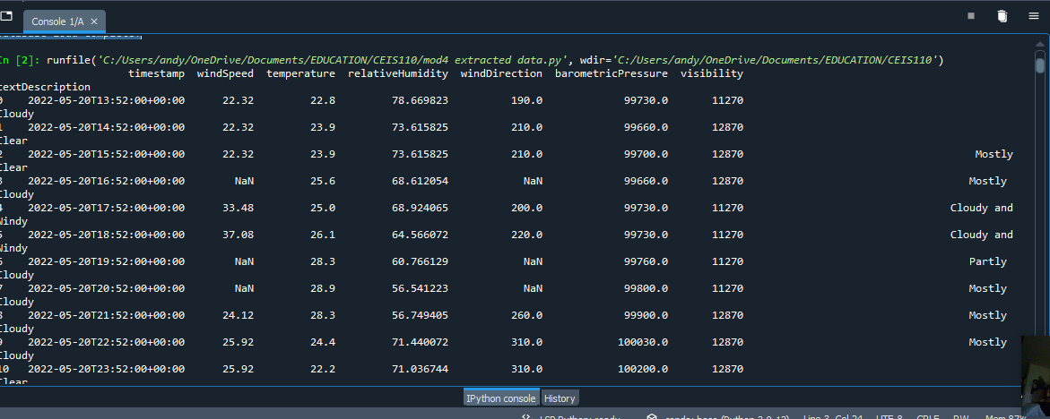
Query to retrieve all columns and all rows (Screenshot)
Screenshot of SQL query command and results

Slide 14
Query to retrieve lowest and highest temperatures (Screenshot)
Screenshot of SQL query command and results

Slide 15
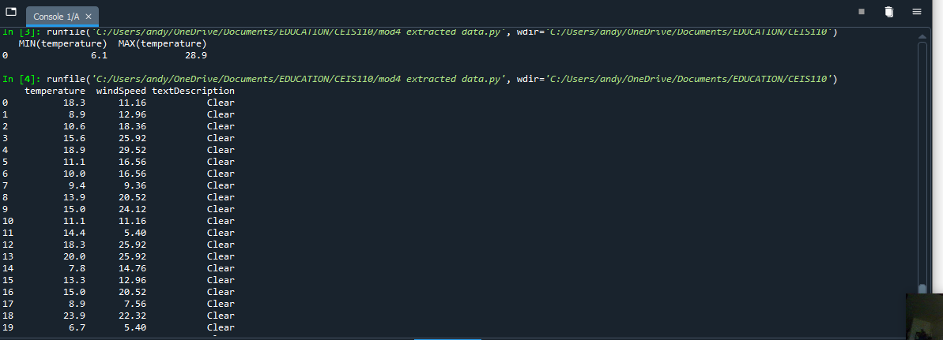
Query to retrieve all clear days (Screenshot)
Screenshot of SQL query command and results

Slide 16
CEIS110 Module 5
Querying and manipulating data with SQL and Python

Slide 17
Rubric
Activity | Requirement(s) | Points
Python code | Screenshot of code | 20
Retrieve and convert data into CSV format | Screenshot of data in Excel file | 20
Temperature and Humidity chart | Chart of data from database | 20

Slide 18
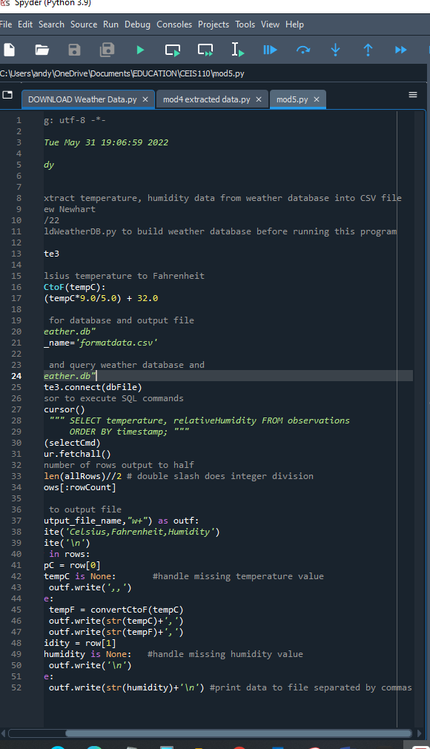
Python code (Screenshot or file)
ExtractTempHumidity.py Python code with your name and date in comments

Slide 19
Retrieve and Convert Data to CSV Format (Screenshot)
Formatdata file open in Excel showing 3 columns of data

Slide 20
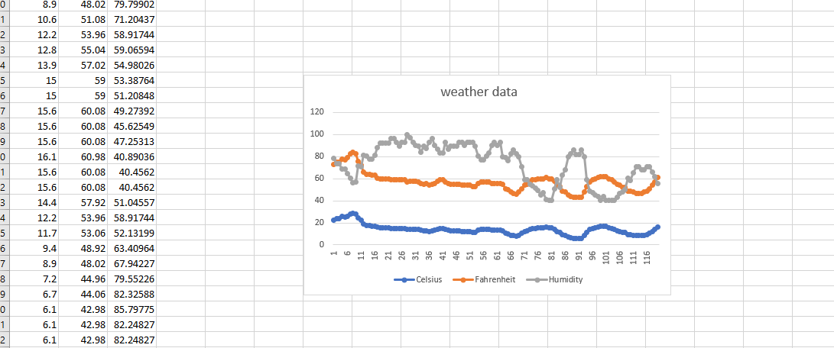
Temperature and Humidity Chart (Graph)
Excel chart based on temperature and humidity data from database

Slide 21
CEIS110 Module 6
Develop Graphical Models and Interpret Results
Andrew Newhart 06/11/22

Slide 22
Rubric
Activity | Requirement(s) | Points
Plot #1 | Picture/screenshot of plot from data with code | 15
Plot #2 | Picture/screenshot of plot from data with code | 15
Analysis | Question, plot, and answer | 15
Prediction | Prediction based on data | 15

Slide 23
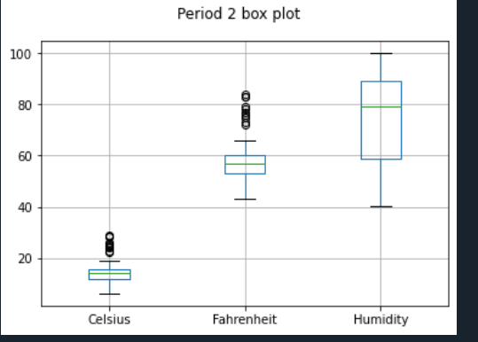
Plot #1
Plot and code used to generate it
Box
Line
Histogram
Scatter
Research your own!

Slide 24
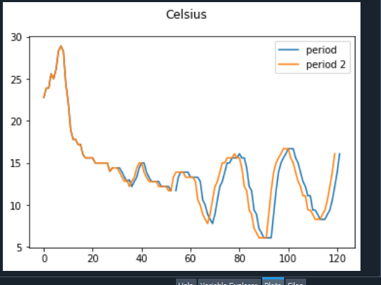
Plot #2 (Screenshots)
Plot and code used to generate it
Box
Line
Histogram
Scatter
Research your own!

Slide 25
Analysis
Think of your own question and create a chart/graph to answer it
Why are the lines so close?
BECASE: Data was same day not days apart
Answer supported by Chart:

Slide 26
Prediction
Develop a prediction based on the data. What variations in temperature and humidity do you expect over the next few hours or days? How would humidity change if temperature goes up or down?
It would appear there is a rise in humidity chiefly based on a rise in Temperature

