Slide 1
NETW-311 Wired, Optical and Wireless Communications with Lab Professor Messaoud Laddada Final Course Project Andrew Newhart 4/18/2024

Slide 2
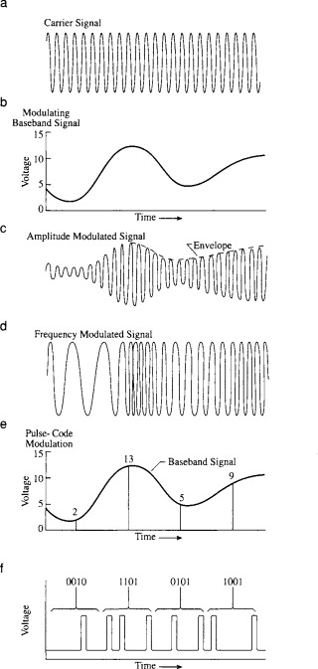
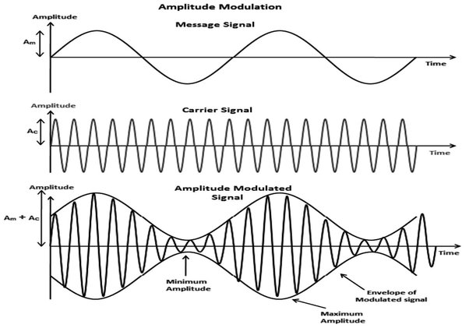
NETW311 Course Project Module 2 Baseband Signals and AM/FM Signals Andrew Newhart 3/31/2024

Slide 3
Expectations:
My expectations in this module was to get reacquainted with wireless communications and networking.
I was pleased to reaffirm many of my old skills in radio communications and wireless bridging between physical locations.
I learned a few new aspects and again resurfaced what education I had from the last century of radio electronics an d transmission controls

Slide 4
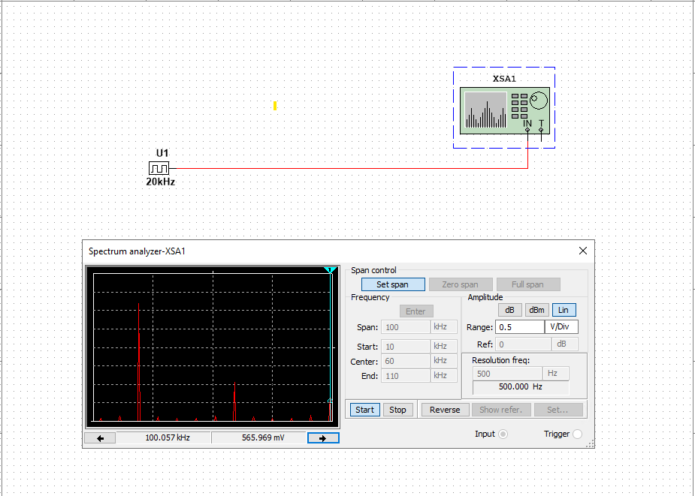
Baseband Signals
The screenshot shows the spectrum analyzer displaying the signal’s harmonic spectrum and its panel settings. I recorded the signal voltage at each of the frequencies in the table.
Harmonic Frequency | Signal (Volts)
20 kHz | 2.0
40 kHz | 0.0
60 kHz | 808
80 kHz | 0.0
100 kHz | 565

Slide 5
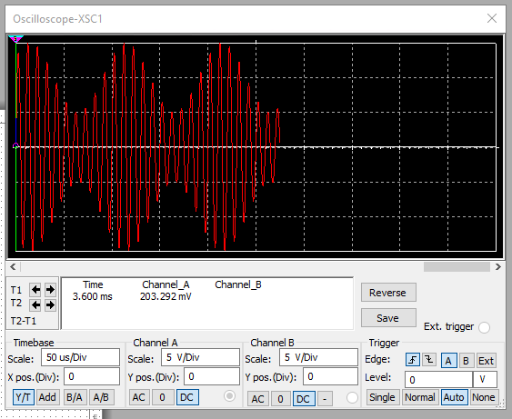
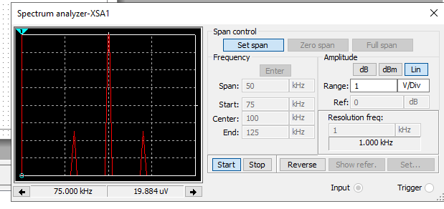
AM Signals
The screenshot of the Oscilloscope includes the signal and the panel settings of the oscilloscope. The screenshot of the Spectrum Analyzer includes the signal and the panel setting of the analyzer.
Oscilloscope screenshot here
Spectrum Analyzer screenshot here
AM Modulation | Frequency (kHz)
Lower side band | 90khz
Carrier | 100khz109
Upper side band | 109khz

Slide 6
AM Signals Cont.
Develop equations for the carrier and modulating signals:
Equations here:
The equation for the carrier signal is:
Vi=10sin(2$π100000t$)
The equation for the modulating signal is:
Vi=5sin(2$π10000t)$

Slide 7
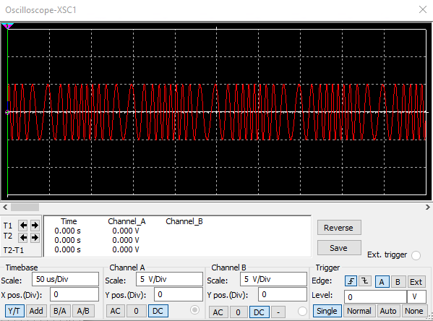
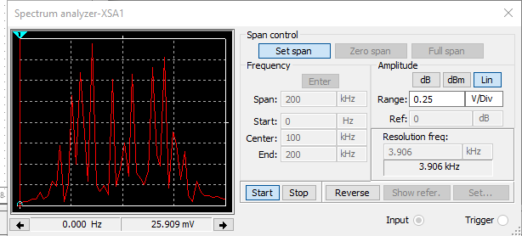
FM Signals
This screenshot of the Oscilloscope includes the signal and the panel settings of the oscilloscope. The screenshot of the Spectrum Analyzer includes the signal and the panel setting of the analyzer.
Oscilloscope screenshot here
Spectrum Analyzer screenshot here
What’s the carrier frequency?
100kHz

Slide 8
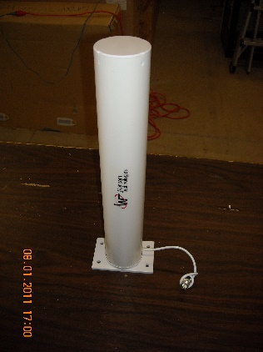
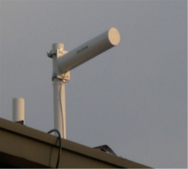
Module Conclusions:
I have many years of installing Wi-Fi in some unusual locations. I have used Yagi’s and Patch antennas in elevator shafts delivering digital signage to its riders. I have also used Cisco wireless network bridges to connect many auto dealers campuses from building to building with out laying cable.
This coarse refreshed my knowledge of RF communications and how we integrated into todays networking as well a great refresher into radio communication and it signal analysis.

Slide 9
NETW310 Course Project Module 3 Pulse Code Modulation (PCM) and Line Codes

Slide 10
Expectations:
My expectations, as in all modules it to get a firm understanding of the material presented. PCM is a something I grew into after years of analog communications training.
A good understanding here will surely be a feather in my cap while troubleshooting analog device communications across todays digital networks.
Things like IoT device such as temperature monitors on grocery store refrigerated cabinets to monitor their operational status.

Slide 11
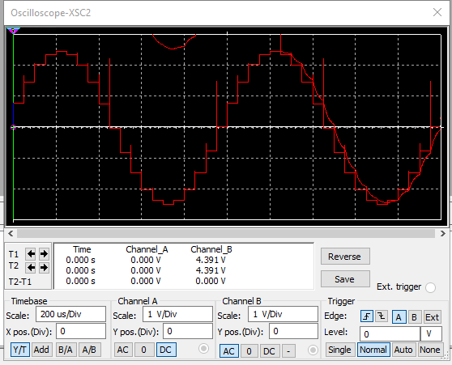
Pulse Code Modulation (PCM)
The first screenshot shows the Oscilloscope-XSC1 display with the analog input signal and sampling clock at the input to the ADC. The second screenshot shows the Oscilloscope-XSC2 display with the output of the DAC. (ZOOM IN)

Slide 12
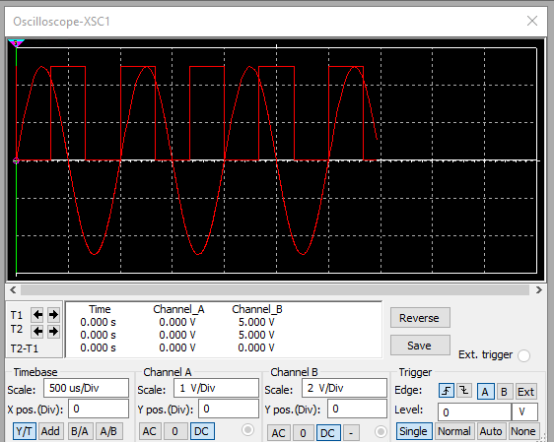
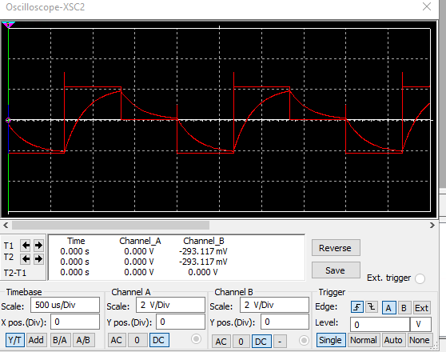
Pulse Code Modulation (PCM)
The first screenshot should show the Oscilloscope-XSC1 display with the analog input signal and sampling clock at the input to the ADC. The second screenshot should show the Oscilloscope-XSC2 display with the output of the DAC.
What are the effects of increasing or decreasing the sampling rate?
Answer: As the sampling frequency decreases, the signal separation also decreases.

Slide 13
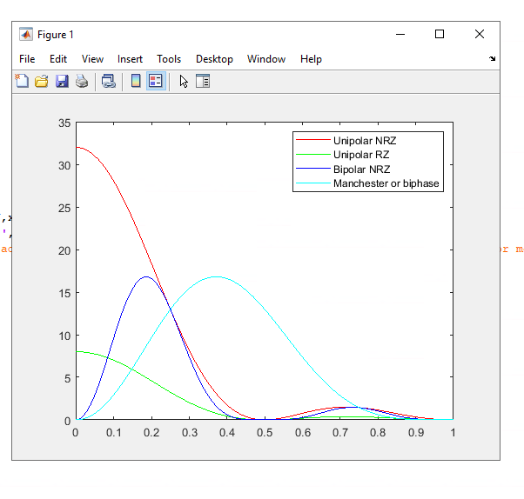
Line Codes
This screenshot shows the power spectral densities of four-line codes: NRZ-Polar, NRZ-Unipolar, NRZ-Bipolar, and Manchester-Polar.
MATLAB Diagram Here
Compare the NRZ-Bipolar and Manchester polar codes in the diagram.
Which one requires more bandwidth?
Answer: Unipolar

Slide 14
Module Conclusions:
I have spent a lot of years working with A to D and D to A conversions. This class reaffirms and strengthens my understanding of the sampling of analog data and the converting to digital data for digital analysis of the data.

Slide 15
NETW310 Course Project Module 4 Cables and Structured Cabling Andrew Newhart 3/31/2024

Slide 16
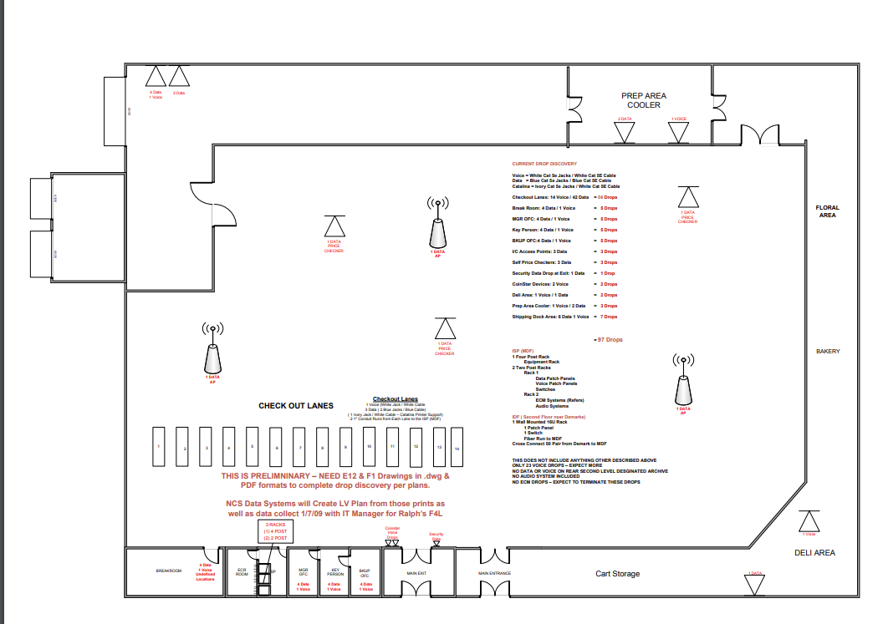
Expectations:
I expected to confirm my knowledge of the physical or layer one infrastructure that I have been installing for many decades and engage others in the standards that have been developed to properly install.

Slide 17
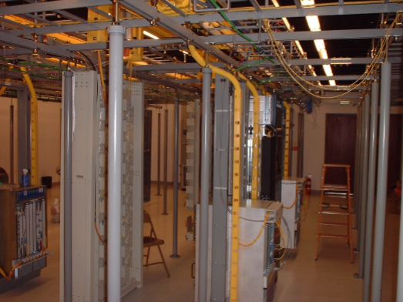
Questions
1. Why must the twisting in the individual wires be maintained in a UTP cable?
Answer: to keep crosstalk and other EMI to interfere with transmissions
2. How many inches should UTP cable be separated from 110 volts electrical cable?
Answer: 12”
3. Horizontal cabling connects what areas to each other?
Answer: Horizontal usually refers the cabling plant on the same floor or level in a muti-floor building and is the cabling leading to the endpoints and workstations.

Slide 18
Questions
4. What is a plenum rated cable?
Answer: Plenum is a cable rated to reduce potential fire hazards by using fire retardant exterior shielding and is usually used and required in plenum areas that manage air or circulation air in a muti-floor building.
5. What is a riser tube used for?
Answer: Riser is referring to vertical cabling plants in a muti-floor building. These are the tubes or cables plants that connect the individual floors to each other or to the MDF in the building.
6. Is the grounding of equipment mostly a safety or a performance concern?
Answer: Both. Safety is a major concern due to the possibility of ground loops and high voltage static but grounding also protects the attached equipment to the rack or device in use allowing any static charges to follow the ground and not effect the operation of the equipment.

Slide 19
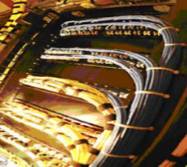
Module Conclusions:
I validated my skillset in this arena. I have been installing and managing installation of miles of copper in categories going back to Cat2 and RG 59 and 62 back in the 80’s.
The inclusion of the BISCI standards and my pursuit of that certification has served me well in establishing a strong understanding of the physical media we utilize today and in the past.

Slide 20
NETW310 Course Project Module 5 Antenna Gain and Free Space Path Loss Andrew Newhart 3/31/2024

Slide 21
Expectations:
I expectation is to strengthen my knowledge in the antenna and transmission and reception losses.

Slide 22
Antenna Gain
1. What is the maximum theoretical antenna gain of a common dish antenna at the 2.4 GHz band? [4 points]
Answer:22.379
2. What is the maximum theoretical antenna gain of a common dish antenna at the 5 GHz band? [4 points]
Answer:29.079
3. Given the same sized reflector, which signals, high-frequency, or low-frequency, can be more efficiently focused by a common dish antenna (i.e., result in a higher antenna gain)? [5 points]
Answer: 2.4Ghz
4. What is the maximum theoretical antenna gain of the dish antenna used in the VLA radio telescopes in New Mexico at the 5 GHz band? [4 points]
Answer: -80.4
5. Given the same signal frequency, which dish antennas, large-sized or small-sized, are more efficient at focusing the signal (i.e., result in a higher antenna gain)? [5 points]
Answer:-87.2

Slide 23
Free Space Path Loss
1. What is the free space path loss in dB at the 2.4 GHz band? [4 points] Answer: -80.4
2. What is the free space path loss in dB at the 5 GHz band? [4 points] Answer:-87.2
3. How does the free space path loss at a higher frequency (e.g., the 5 GHz band) compare with that at a lower frequency (e.g., the 2.4 GHz band)? [5 points]
Answer: A greater loss at the lower 2.4Ghz freq.
4. What is the free space path loss in dB over 20 meters at the 2.4 GHz band? [4 points]
Answer: -86.421
5. What is the free space path loss in dB over 40 meters at the 2.4 GHz band? [4 points]
Answer: -92.441
6. What is the free space path loss in dB over 80 meters at the 2.4 GHz band? [4 points]
Answer: -98.462
7. When the distance doubles, how does free space path loss in dB change approximately? [5 points]
Answer: approx. 6db

Slide 24
Module Conclusions:
This module has identified some of the knowledge on antenna gain and losses that I used many years ago and opened up deficiencies in my knowledge that need to be secured.

Slide 25
NETW310 Course Project Module 6 Bit Error Rate of Fading Channels Andrew Newhart 4/87/24

Slide 26
Expectations:
I expectation is to gain knowledge in the examining data errors on streams on different channels and their performance differences.

Slide 27
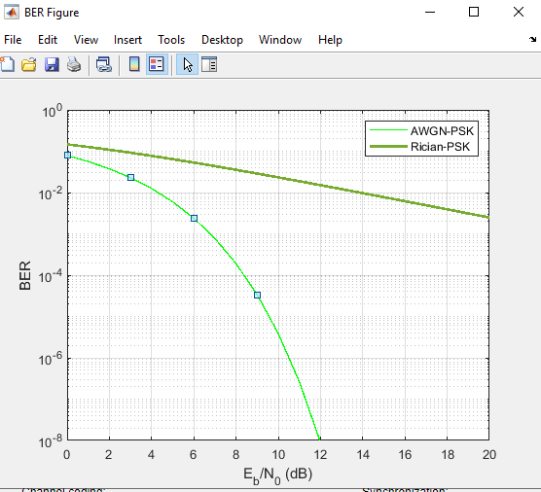
AWGN Channel and Rician Channel
This screenshot shows the bit rate error performance of both AWGN and Rician fading channels.

Slide 28
AWGN Channel and Rician Channel
Compare and contrast the BER performance of PSK over a noise limited (AWGN) transmission channel to the performance of PSK over a Rician channel at 5- and 10-dB Signal to Noise Ratio (E_{b}/N₀), respectively.
Is there a significant difference in BER performance of PSK between the AWGN channel and Rician channel?
Answer: It appears to me that Rician fading channel is worse than that of AWGN channel and better than that of Rayleigh fading channel. Because Rician fading channel has higher BER than AWGN channel and lower than Rayleigh fading channel.

Slide 29
Module Conclusions:
This module has introduced me into a much deeper analysis of the SNR analysis in transmissions.

Slide 30
NETW-310 Class Conclusion:
This class has not only taken me through a great refresher of skills I had learned decades ago and not used much in the last decade and shown me a more in-depth understanding of the analysis of wireless communications that we all need to be skilled in to successfully maintain strong and secure data and voice networks.
This class has been especially close to my original entry into electronics as a young man and has inspired me to learn more in the arena and become precise in the analysis of this kind of these communication medias.

