Slide 1
NETW211 Course Projects
Professor Alan Rynarzewski
Andrew M. Newhart
September/October 2022

Slide 2
NETW211 Course Project
Module 2 Virtual Machine (VM) Instances
Objectives
In this module, I will explore the Azure virtual machine (VM) service that provides secure and resizable compute capacity in the cloud.

Slide 3
INTRODUCTION:
This course will give me a great footing into cloud –based platforms and practices. My expectation are to be proficient if not at least a clear understanding of the tools and developmental products to help complement my IoT understanding and how you can develop networks that are virtually –based and accessible globally.
Rubric
Activity | Requirement(s) | Points
Deploying a VM in Azure | Screenshot | 10
Connecting to the VM | Screenshot | 10
Deleting the VM | Screenshot | 10

Slide 4
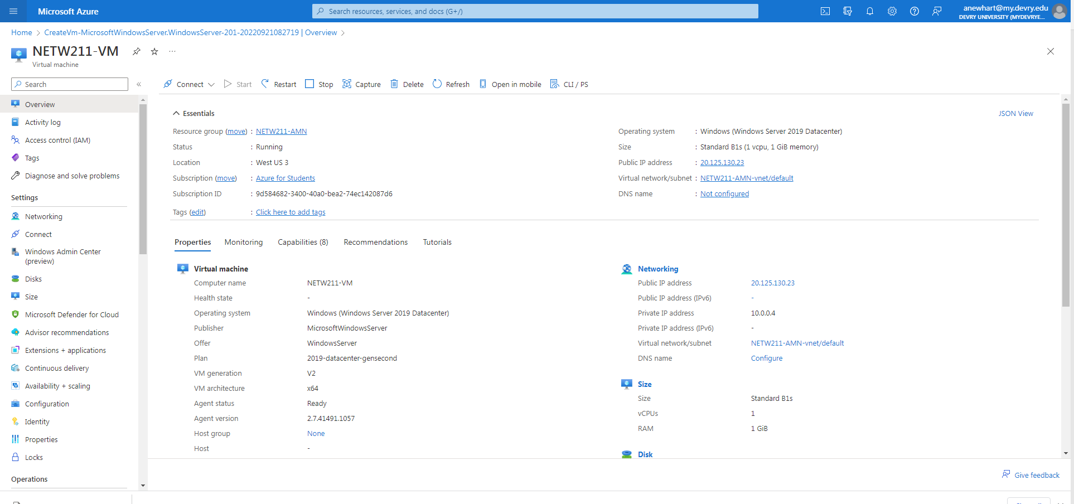
This screenshot should show the NETW211VM page with information such as the resource group name, subscription, public IP address, etc.
Deploying a VM in Azure

Slide 5
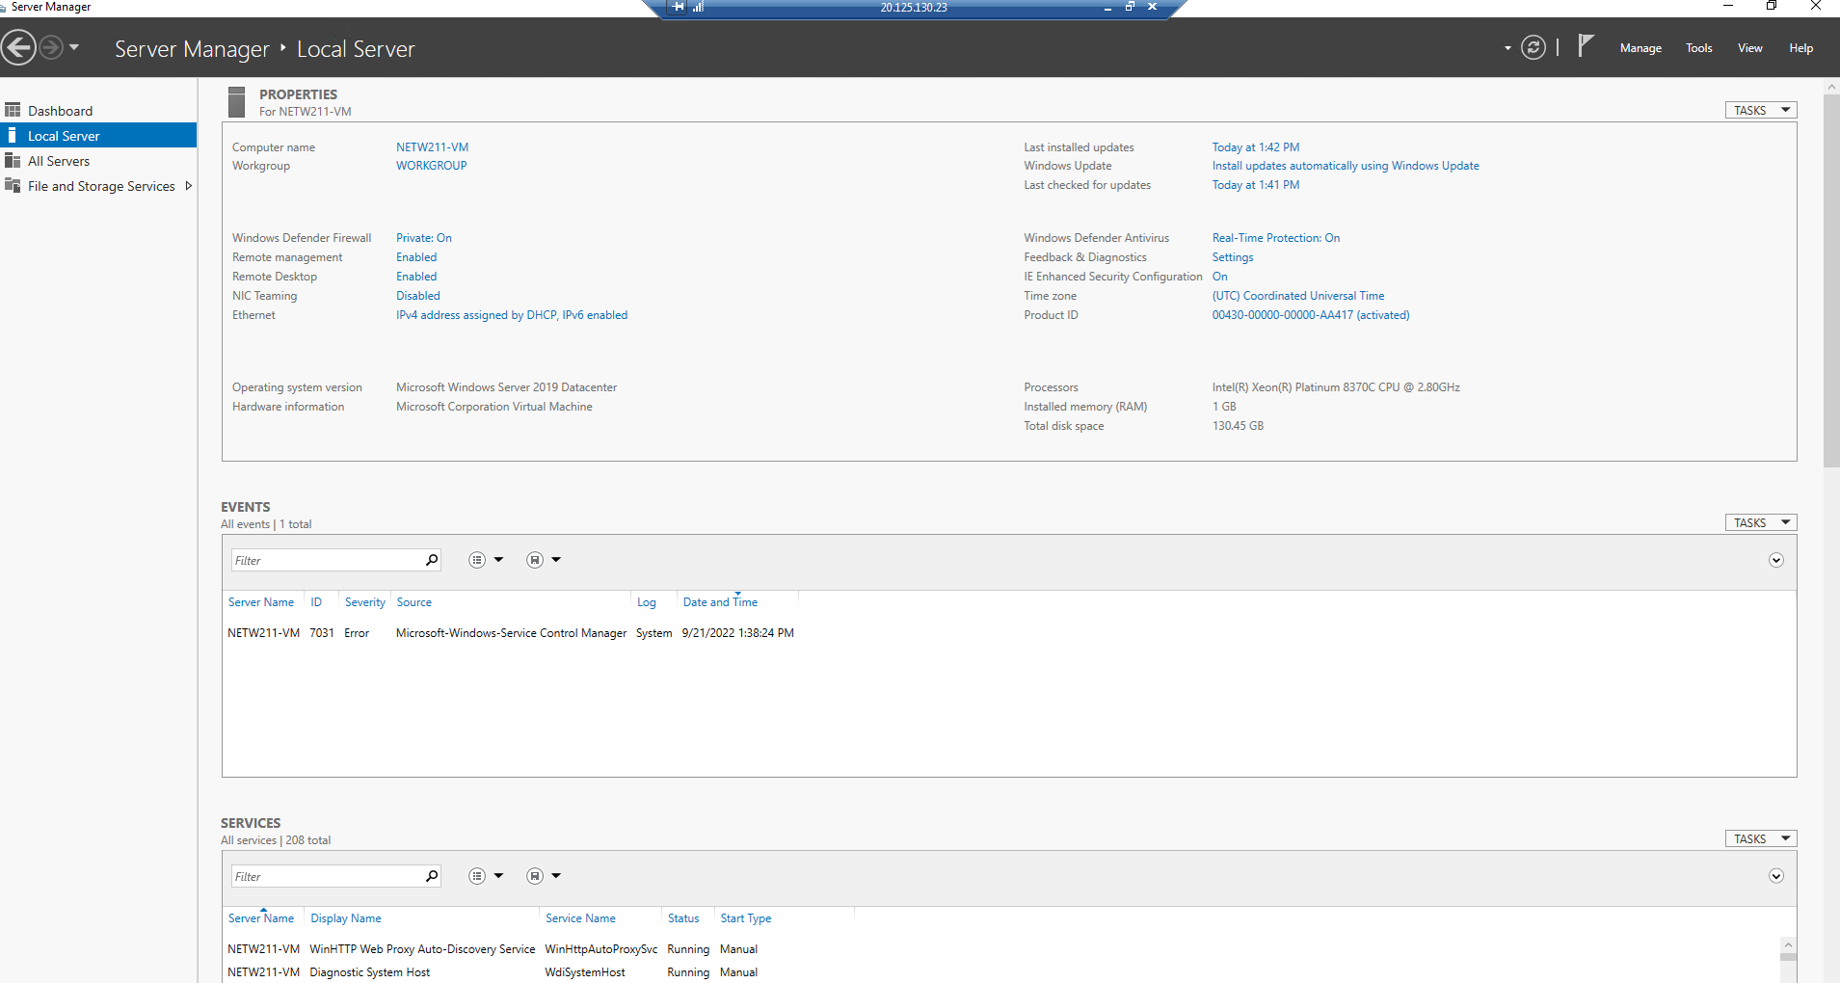
Connecting to the VM
This screenshot should show the PROPERTIES for NETW211VM page, with the computer name, operating system version, hardware information, etc.

Slide 6
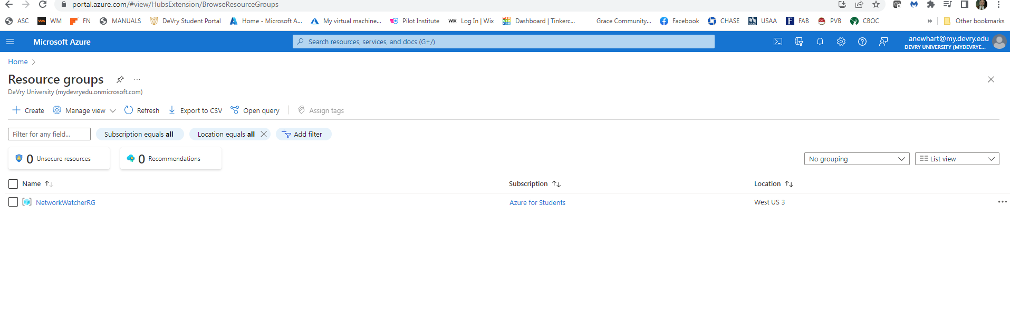
Deleting
the VM
This screenshot should show the Resource groups page, with the Azure for Students subscription selection and the “No resource groups to display” message.

Slide 7
Conclusions:
Creating a VM in Azure was a helpful insight into the basis of what cloud computing can be. It appears easy on the surface but I quickly learned, with a little fooling around, that these VM’s can be configured to be more robust than what you would expend on a real-world metal server.
Changing the parameters of your server or ‘VM’ computing needs and it capabilities is certainly easier than in the real-world hardware changes and upgrades.

Slide 8
NETW211 Course Project
Module 3 Azure VNet and Subnets
Andrew Newhart

Slide 9
Objectives for the module should leave me with a understanding of Cloud VNets.
LABs simulate a VNet on Azure and allow us to define both IP network parameters as well as subnet configuring on the Vnet.
Rubric
Activity | Requirement(s) | Points
Creating a VNet with Two Subnets | Questions | 20
Deploying VMs into Subnets | Three Screenshots | 30
Verifying Connectivity between VMs | Two Screenshots | 10

Slide 10
Creating a VNet with Two Subnets
1. With a /24 network prefix, how many usable IPv4 host addresses are there? [hint: you learned this in NETW191]
Answer here: 256 – NET ID & BROADCAST = 254
REF: - ANY IP training….cicra 1994 – Just know this…
2. Given the answer above, why is the number of available IP addresses for Subnet0 (10.0.0.0/24) or Subnet1 (10.0.1.0/24) shown as 251? [hint: where did the missing addresses go?]
Answer here: On Azure you are allowed 251 since they reserve 5 addresses. Azure resureves 5 address as detailed below:
192.168.1.0 : Network address
192.168.1.1 : Reserved by Azure for the default gateway
192.168.1.2, 192.168.1.3 : Reserved by Azure to map the Azure DNS IPs to the VNet space
192.168.1.255 : Network broadcast address.
REF: https://learn.microsoft.com/en-us/azure/virtual-network/virtual-networks-faq
References (here are two examples to get your research started):
1. IP Subnet Calculator, https://www.calculator.net/ip-subnet-calculator.html
2. Azure Virtual Network frequently asked questions, https://docs.microsoft.com/en-us/azure/virtual-network/virtual-networks-faq

Slide 11
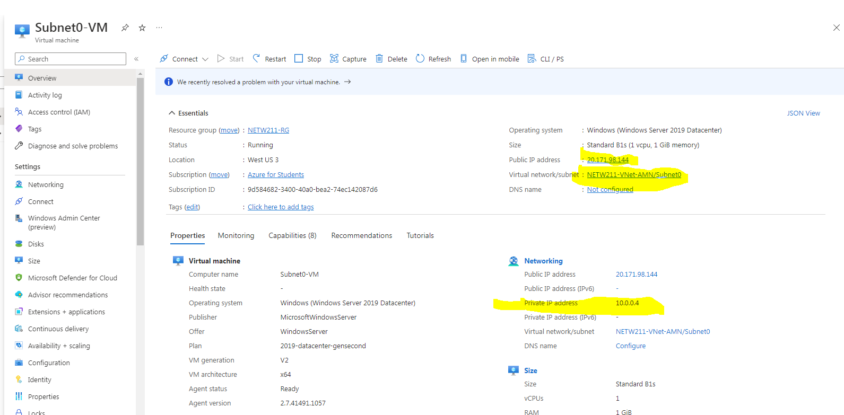
Deploying VMs into Subnets
This screenshot should show the Properties section of the Subnet0-VM page, showing the networking and size information of the VM.

Slide 12
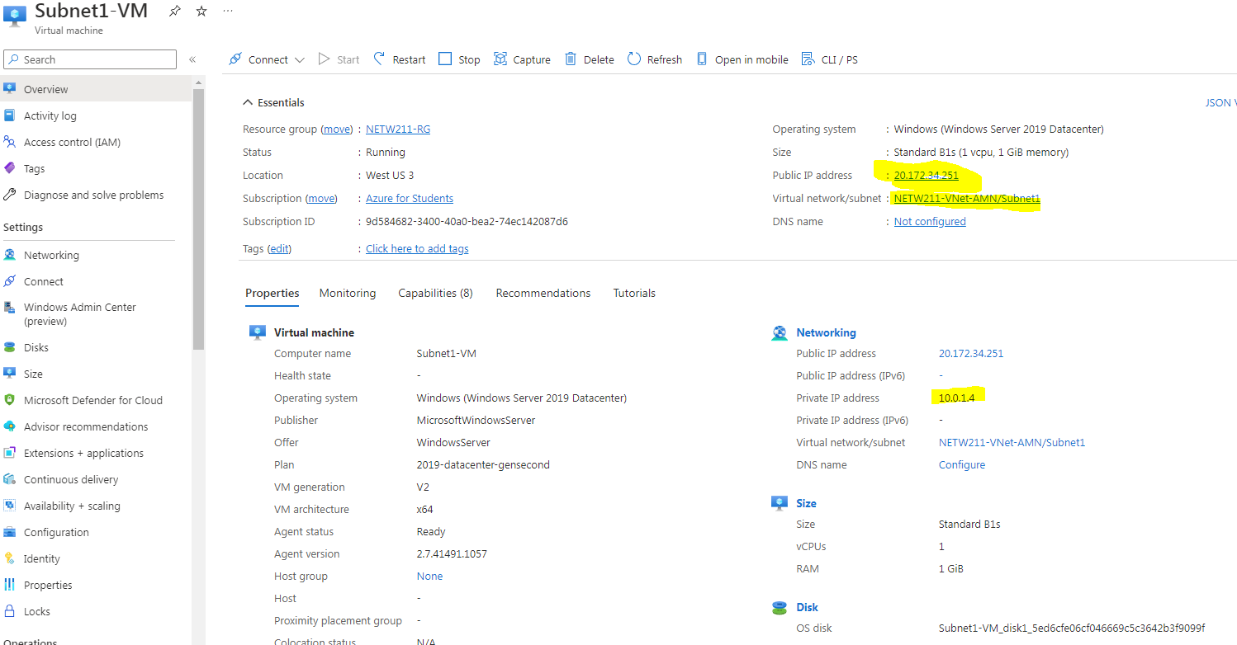
Deploying VMs into Subnets cont’d
This screenshot should show the Properties section of the Subnet1-VM page, showing the networking and size information of the VM.

Slide 13
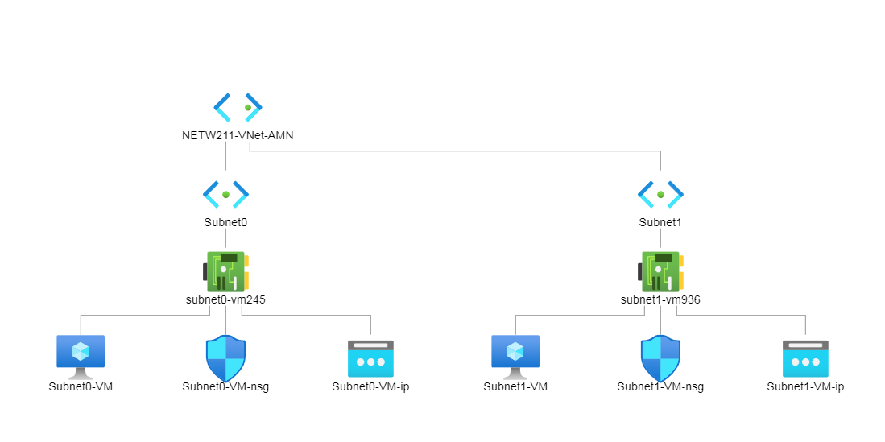
Deploying VMs into Subnets cont’d
This screenshot should show the topology diagram of your VNet (NETW211-VNet-Your Initials) with two subnets (Subnet0 and Subnet1) and one VM in each subnet (Subnet0-VM and Subnet1-VM).

Slide 14
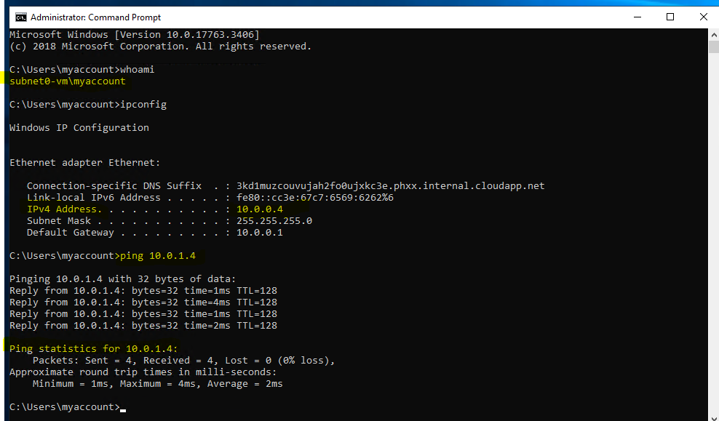
Verifying Connectivity between VMs
This screenshot should show the ipconfig and ping x.x.x.x results in the command prompt window, including the Subnet0-VM – x.x.x.x – Remote Desktop Connection window title.

Slide 15
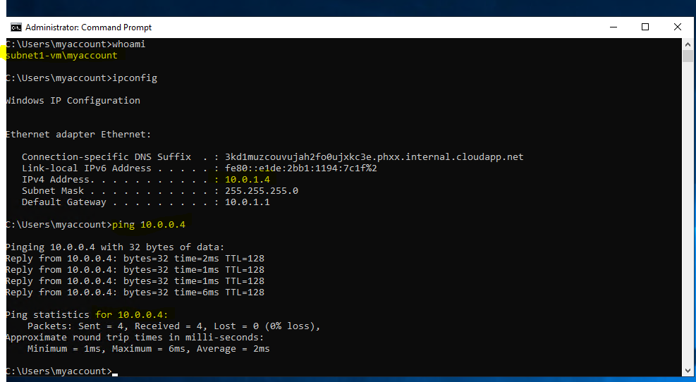
Verifying Connectivity between VMs
cont’d
This screenshot should show the ipconfig and ping x.x.x.x results in the command prompt window, including the Subnet1-VM – x.x.x.x – Romote Desktop Connection window title.

Slide 16
Module 3 Conclusions
What I learned here was the intricacy as well as the flexibility to configure your networks (VNets) is relatively easy.
I did learn that, as with all user developmental tools I’ve used, there are issues if you do NOT configure correctly. When attempting to communicate between VM’s or VNets, the parameters you used will surely create connectivity or problems.
Although these are issues that may arise when developing without any experiences as we did this module. I am sure after continued use and practice these issues will not arise.

Slide 17
NETW211 Course Project
Module 4 Azure VM Security
Andrew Newhart

Slide 18
This module will further my skills at teach the AZURE VM security options.
Rubric
Activity | Requirement(s) | Points
Launching a VM | Screenshot | 15
Connecting to the VM via SSH | Screenshot | 15
Configuring an NSG | Two screenshots | 30

Slide 19
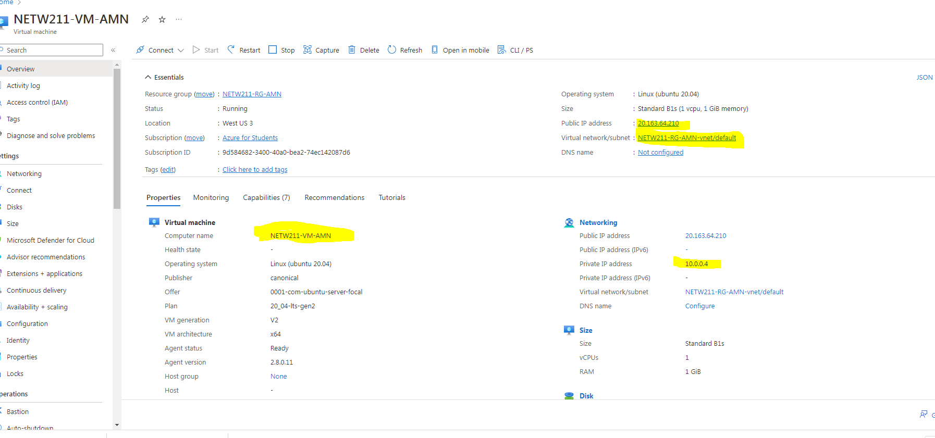
Launching a VM
This screenshot should show the NETW211-VM-Your Initials page, with information such as the resource group name, subscription, public IP address, etc.

Slide 20
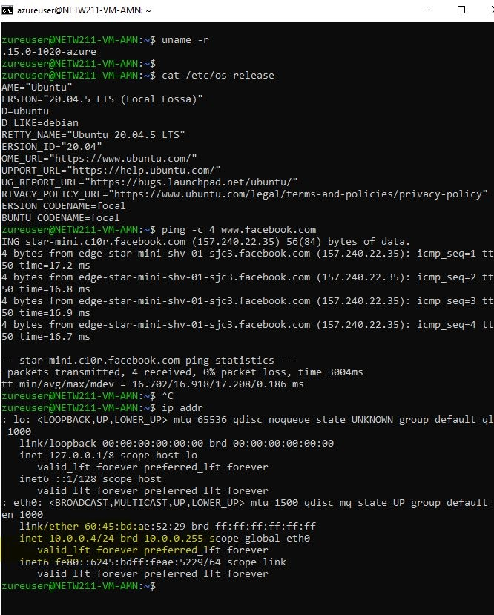
Connecting to the VM
via SSH
This screenshot should show the azureuser@NETW211-VM-Your Initials window showing the IPv4 address of the VM in the Azure cloud.

Slide 21
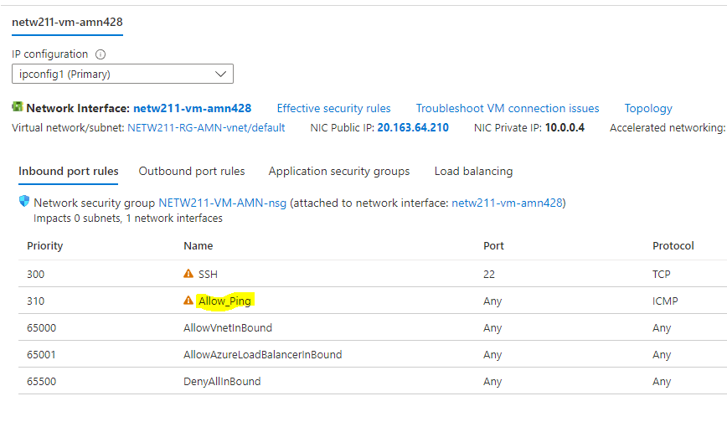
Configuring an NSG
This screenshot should show the Inbound port rules section with the newly added Allow_Ping rule.

Slide 22
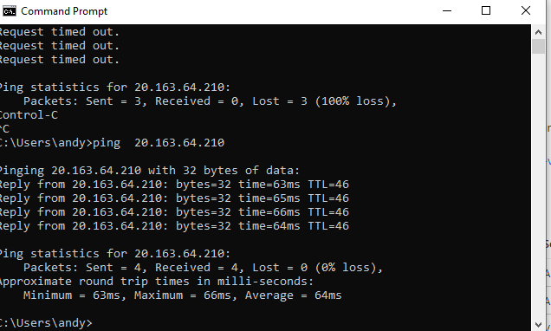
Configuring an NSG
cont’d
This screenshot should show the successful ping result from your local computer to the VM in the Azure cloud.

Slide 23
Conclusions
Learning Azure VM security and the use of NSG’s will help me organize my ability to develop a sound VM
Practice with this lab, and I will play with my Azure account, will sharpen my skills in basic VM & NSG configurations.

Slide 24
NETW211 Course Project
Module 5 Cloud Storage
Andrew Newhart 10/1/22

Slide 25
This module will teach me about Azure’s cloud storage options and its “BLOB” storage tools.
Rubric
Activity | Requirement(s) | Points
Uploading and Accessing a File | Screenshot | 15
Creating Blob Snapshots | Question, Screenshot | 30
Enabling Blob Versioning | Screenshot | 15

Slide 26
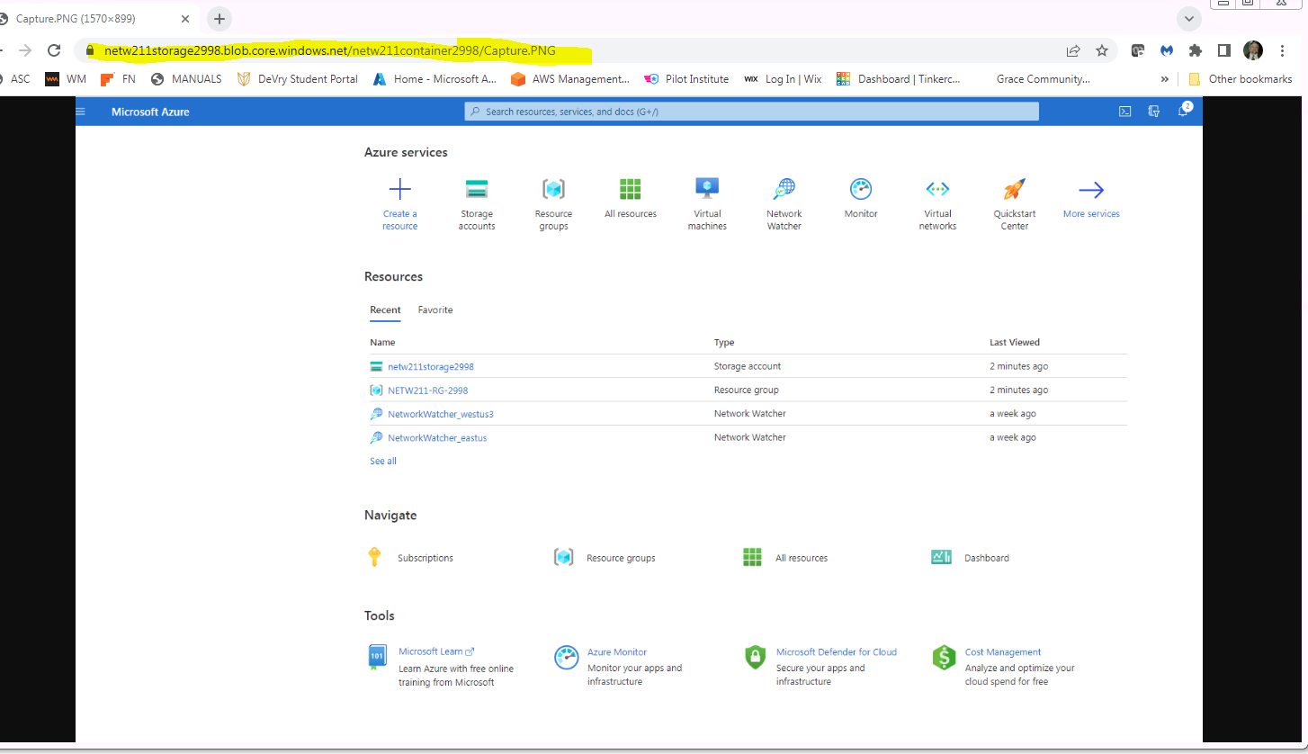
This screenshot should show the browser window with the image uploaded from your local computer and the URL on top of the window.
Uploading and Accessing a File

Slide 27
Question
What does the access tier setting do? What are the Azure blob storage access tiers?
[hint: in the Azure portal, on the Upload blob page, under Advanced, click the ? circle above the Access tier box.]
Answer here:
Data stored in the cloud grows at an exponential pace. To manage costs for your expanding storage needs, it can be helpful to organize your data based on how frequently it will be accessed and how long it will be retained. Azure storage offers different access tiers so that you can store your blob data in the most cost-effective manner based on how it's being used. Azure Storage access tiers include:
Hot tier - An online tier optimized for storing data that is accessed or modified frequently. The hot tier has the highest storage costs, but the lowest access costs.
Cool tier - An online tier optimized for storing data that is infrequently accessed or modified. Data in the cool tier should be stored for a minimum of 30 days. The cool tier has lower storage costs and higher access costs compared to the hot tier.
Archive tier - An offline tier optimized for storing data that is rarely accessed, and that has flexible latency requirements, on the order of hours. Data in the archive tier should be stored for a minimum of 180 days.
Azure storage capacity limits are set at the account level, rather than according to access tier. You can choose to maximize your capacity usage in one tier, or to distribute capacity across two or more tiers.
references (here are two examples to get your research started):
1. Hot, Cool, and Archive access tiers for blob data, https://docs.microsoft.com/en-us/azure/storage/blobs/access-tiers-overview
2. Azure Blob Storage Access Tiers, https://devry.percipio.com/courses/c7ef0333-8560-403f-a004-9c5c843866b0/videos/2658bbe6-ee97-438b-a376-fbb079c3b3a0
3.
4.

Slide 28
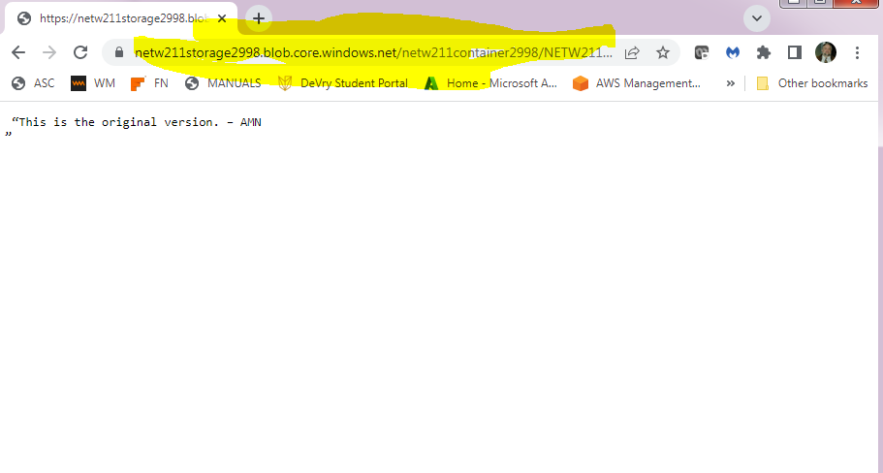
Creating Blob Snapshots
This screenshot should show the browser window with the “This is the original version. –Your Initials” message and the URL on top of the window

Slide 29
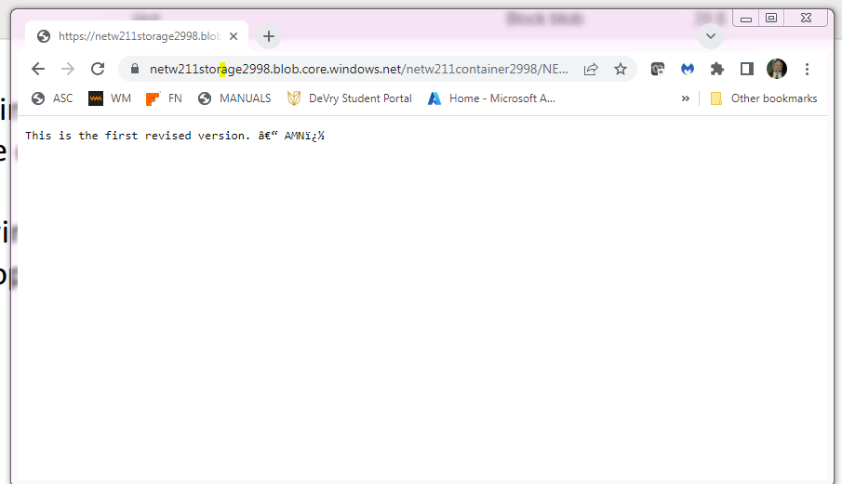
Enabling Blob Versioning
This screenshot should show the browser window with the “This is the first revised version. –Your Initials” message and the URL on top of the window.

Slide 30
Conclusions
Familiarization with Azures data storage options
Data Container creation and configurations
Azure” Blob” usage
This was a useful module of storage and the best methods of storing data based on access and usage requirements

Slide 31
NETW-211 Course Project
Module 6 Cloud Monitoring
Andrew Newhart 10/9/22

Slide 32
This module will introduce me in the Cloud Monitoring tools and their usage.
Developing Alerts and rules, as-well-as notification profiles to help monitor the state of fitness of your Azure VNet products
Rubric
Activity | Requirement(s) | Points
Setting up an Action Group and Notifications | Screenshot | 20
Setting up Alert Rules | Screenshot | 20
Testing Alerts | Two screenshots | 20

Slide 33
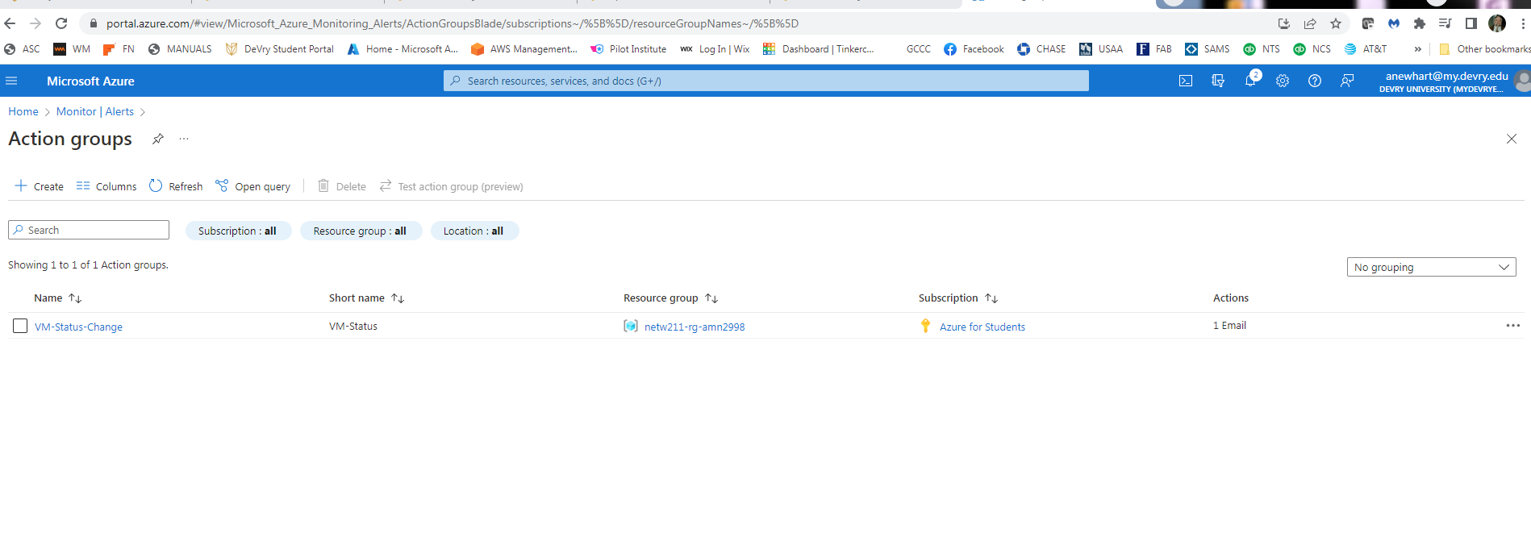
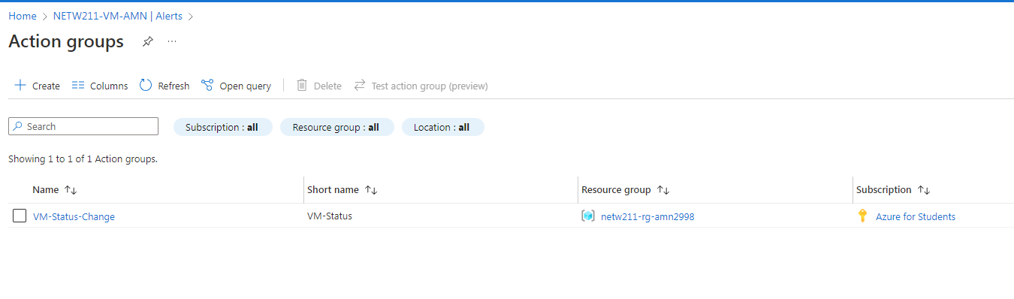
Setting up an Action Group and Notifications
This screenshot should show the “VM-Status-Change” action group on the Manage actions page.

Slide 34
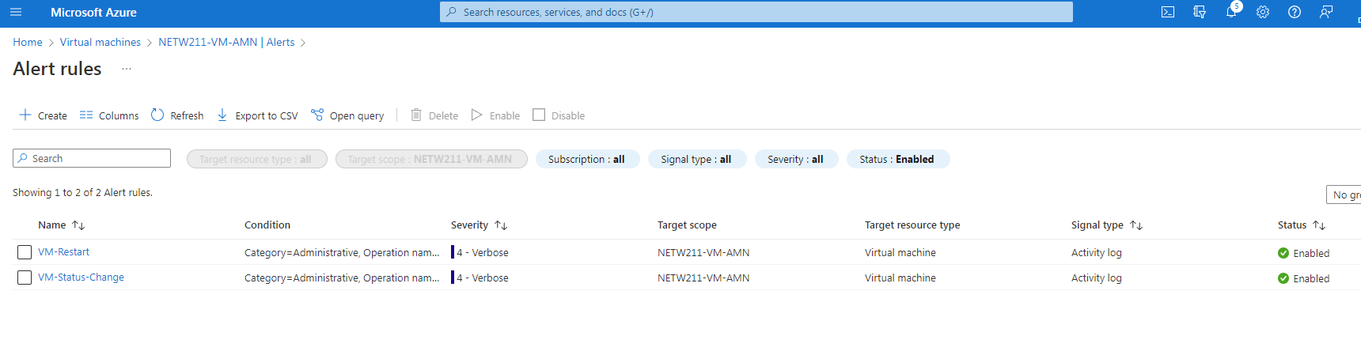
Setting up Alert Rules
This screenshot should show the Alert rules window showing the VM-Deallocate and VM-Restart rules.

Slide 35
Testing Alerts
This screenshot should show the ‘VM-Restart’ was activated email message with the date and time of the alert.

Slide 36
Testing Alerts cont’d
This screenshot should show the ‘VM-Deallocate’ was activated email message with the date and time of the alert.

Slide 37
Conclusions:
This module was a perfect cap to the preceding Cloud product creation and configuration modules.
Understanding the points of failure you can monitor and creating rules that will notify admins.

Slide 38
NETW-211 CLASS CONCLUSIONS
This class was a great introduction to networking ion the cloud and what Azure has to offer
I learned how to create networks and machines in a virtual world and as equally import how to secure them and the data they utilize
I look forward to seeking the CompTIA Could_ cert as well and my working through the Azure certifications and other cloud platform providers training.
I have already started an Azure account and use it daily to test and play with options to help familiarize myself with these tools and begin the training for their certifications.
This class was a “Hoot” and I learned a lot but mostly made me realize the correlation between the virtual “Cloud” world and the physical world of data networking and communication I am familiar with.
Thank you Professor Rynarzewski for your help and confidence you provided me to help me successfully (I Hope) complete this class.

